Slide 1

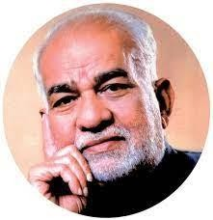
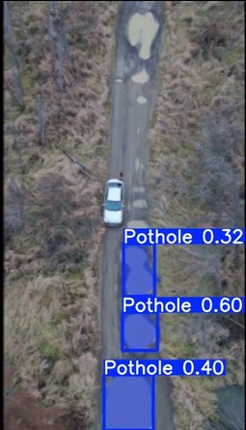
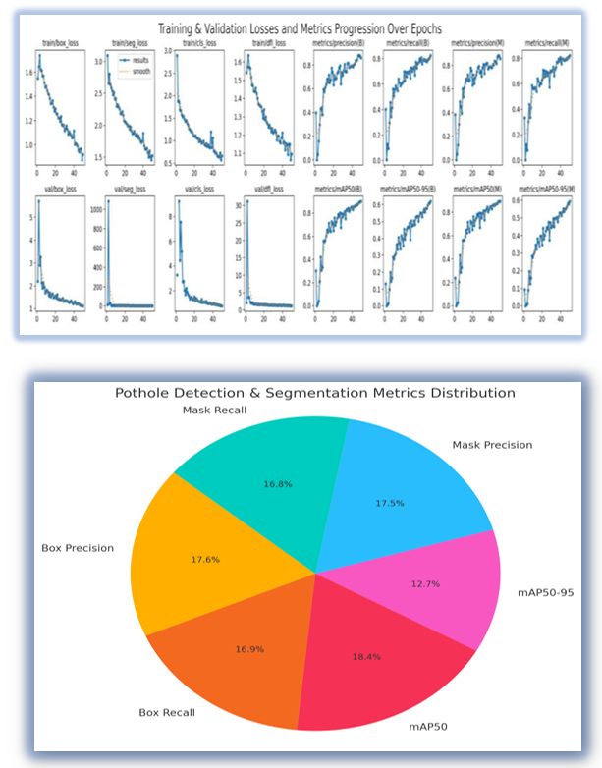
BVRIT HYDERABAD College of Engineering for Women
(UGC Autonomous)
POTHOLE DETECTION REVOLUTION: INTEGRATING VISION FOR SAFER ROADS
R&D SHOWCASE 2025
ABSTRACT
Pothole detection is vital for smart city road safety, but traditional methods often lack real-time capability. We present a vision-based system using a camera and edge computing for real-time detection and mapping. Data is sent to a central server for instant analysis. Field tests show this lightweight, cost-effective solution enables scalable, real-time road monitoring
Pothole Detection
SOCIETAL USE
Pothole Detection Revolution holds significant societal value by enabling efficient and accurate detection of potholes on roads, which are a major cause of vehicle damage and accidents.. Municipal authorities can use the system to monitor infrastructure health at scale, reducing manual inspection efforts and costs. Ultimately, it contributes to safer transportation, lower repair expenses, and enhanced public mobility.
UNIQUENESS
Instance-Segmentation | Video-Processing
Real-world-Deployment | Multi-metric-Evaluation
CONCLUSION
This project demonstrates the effective use of YOLOv11-Seg for accurate pothole detection and segmentation, combining advanced deep learning with practical video analysis. By automating pothole identification, it offers a scalable solution that can significantly benefit transportation infrastructure management.
Results & Analysis
METHODOLOGY
The methodology uses YOLOv11-Seg model, designed specifically for instance segmentation, was then trained on the processed dataset. Model performance was evaluated using comprehensive metrics including mAP50-95, MaskF1, and Box Precision, and subsequently deployed to generate output videos with precise, overlaid pothole detections.
REFERENCES
Dong D, Li Z. Smartphone sensing of road surface condition anddefect detection. Sensors. 2021 Aug 12;21(16):5433. M. G. G. G. I. Oche Alexander
Chen D, Chen N, Zhang X, Guan Y. Real-time road pothole mappingbased on vibration analysis in smart city. IEEE Journal of selectedtopics in applied Earth observations and remote sensing. 2022 Aug19;15:6972-84.
Inventors: Ms. Anjani Uttarkar |Ms. Sumanashri Kota | Ms.Manaswini Reddy
Faculty Mentor : Asst prof. V Manya Email Id: manya.v@bvrithyderabad.edu.in
SDG -11

